Slide 1
Physical Education Intent
Intent
At Ditton Lodge our vision statement is that 'Together we succeed as lifelong learners'. This is carried throughout every area of the curriculum including PE.
Our values are that children LEARN (Listen, Enjoy & take risks, Aim high & achieve, Respect and Never give up) these values will be demonstrated by students within each lesson.
Students will gain an understanding of different religions and practises of worship and life around the world. Students will use and develop their reasoning and discussion skills and learn to respond to others’ ideas and points of view appropriately.

Slide 2
Physical Education
At Ditton Lodge Community Primary School, Physical Education is an integral part of our curriculum that is inclusive and engages all pupils. We want the pupils to be inspired and develop a lifelong passion for Sport and Physical Activity within our children. Children develop the knowledge, skills, and competence to excel in a broad range of sports and physical activities. We aim to deliver high-quality teaching and learning opportunities that enables all children to achieve their personal best.
Intent

Slide 3
Physical Education
Children regularly participate in competitive sports via intra house and inter school competitions through the Schools Sport Partnership. P.E lessons require children to be physically active for sustained periods of time, increasing strength stamina and flexibility and be able to make informed decisions to lead healthy and active lives. Swimming is an important life skill, by Year 6 we aspire for all children to leave primary school being able to swim at least 25 metres to meet national curriculum attainment target. Where possible, physical activity will be present in wider areas of the curriculum to re-enforce the importance of physical health and wellbeing.
Intent

Slide 4
Physical Education
Aims
The national curriculum for physical education aims to ensure that all pupils:
develop competence to excel in a broad range of physical activities
are physically active for sustained periods of time
engage in competitive sports and activities
lead healthy, active lives.
(The National Curriculum, 2014)
Intent

Slide 5
Physical Education
National Curriculum (KS1)
Key stage 1 Pupils should develop fundamental movement skills, become increasingly competent and confident and access a broad range of opportunities to extend their agility, balance and coordination, individually and with others. They should be able to engage in competitive (both against self and against others) and co-operative physical activities, in a range of increasingly challenging situations.
Pupils should be taught to:
master basic movements including running, jumping, throwing and catching, as well as developing balance, agility and co-ordination, and begin to apply these in a range of activities
participate in team games, developing simple tactics for attacking and defending
perform dances using simple movement patterns
Intent

Slide 6
Physical Education
National Curriculum (KS2)
Pupils should continue to apply and develop a broader range of skills, learning how to use them in different ways and to link them to make actions and sequences of movement. They should enjoy communicating, collaborating and competing with each other. They should develop an understanding of how to improve in different physical activities and sports and learn how to evaluate and recognise their own success.
Pupils should be taught to:
use running, jumping, throwing and catching in isolation and in combination
play competitive games, modified where appropriate [for example, badminton, basketball, cricket, football, hockey, netball, rounders and tennis], and apply basic principles suitable for attacking and defending
develop flexibility, strength, technique, control and balance [for example, through athletics and gymnastics]
perform dances using a range of movement patterns
take part in outdoor and adventurous activity challenges both individually and within a team
compare their performances with previous ones and demonstrate improvement to achieve their personal best.
Intent

Slide 7
Physical Education
Why is PE important?
Children learn to appreciate the significance of exercising for a lifetime.
Consistent, physical activity is the best way for us to eradicate obesity and sustain a suitable body weight. It also offers a positive alternative to watching television or playing on computers and mobile phones.
Children learn the fundamental motor skills that will allow them to develop the physical capability that in turn will produce confidence and leads to safe and successful involvement in a wide range of sports.
Children are encouraged to increase their fitness levels during PE including muscular and cardiovascular endurance, strength and flexibility.
Youngsters can learn valuable lessons about accepting responsibility for their individual development leading to greater self-discipline.
PE gives chances for children to be creative, cooperative and competitive and to face up to diverse challenges both as individuals and in groups.
A ‘good workout’ helps ease anxiety, tension and stress and will result in improved attention in class.
Movement can be used to strengthen the understanding of several subjects taught in the classroom e.g. mathematics. Movement has also been shown to heighten the function of our brain.
Many activities taught in PE require children to work in groups to solve problems. These opportunities are outstanding for learning both leadership and teamwork.
Intent

Slide 8
Cross Curricular Links
Physical Education provides opportunities for pupils to develop the key skills of:
Communication and teamwork
Music and Dance
PSHE
Science
Math
Geography
Intent

Slide 9
Progress
Key stage 1 Pupils should develop fundamental movement skills, become increasingly competent and confident and access a broad range of opportunities to extend their agility, balance and coordination, individually and with others. They should be able to engage in competitive (both against self and against others) and co-operative physical activities, in a range of increasingly challenging situations.
Pupils should be taught to:
master basic movements including running, jumping, throwing and catching, as well as developing balance, agility and coordination, and begin to apply these in a range of activities
participate in team games, developing simple tactics for attacking and defending
perform dances using simple movement patterns
Implementation

Slide 10
Progress
Key stage 2 Pupils should continue to apply and develop a broader range of skills, learning how to use them in different ways and to link them to make actions and sequences of movement. They should enjoy communicating, collaborating and competing with each other. They should develop an understanding of how to improve in different physical activities and sports and learn how to evaluate and recognise their own success.
Pupils should be taught to:
use running, jumping, throwing and catching in isolation and in combination
play competitive games, modified where appropriate [for example, badminton, basketball, cricket, football, hockey, netball, rounders and tennis], and apply basic principles suitable for attacking and defending
develop flexibility, strength, technique, control and balance (for example, through athletics and gymnastic) perform dances using a range of movement patterns
take part in outdoor and adventurous activity challenges both individually and within a team
compare their performances with previous ones and demonstrate improvement to achieve their personal best.
swim competently, confidently and proficiently over a distance of at least 25 metres.
use a range of strokes effectively (for example, front crawl, backstroke and breaststroke)
perform safe self-rescue in different water-based situations.
Implementation

Slide 11
Implementation
Children participate in high-quality PE lessons timetabled for 2 hours a week covering two different sports/skills per term.
Teachers use, and adapt, Cambridgeshire Scheme of Work and other P.E specific resources such as LTA school youth tennis scheme for planning lesson content and to ensure lessons across years show progression and all aspects of the National Curriculum are met.
Classes follow the PE long term plan overview to ensure pupils participate in a variety of sports and games with progression through the year groups.
Early Years children are taught physical development in the early year framework
Key Stage 1 children are taught a range of fundamental skills to develop agility, balance, and coordination
Key Stage 2 plays modified competitive games and apply and develop a broader range of skills as well as learn how to evaluate and recognise their own success.
Key Stage 2 Residential Trips provide extra outdoor and adventurous activities and team building skills for their well-being and enhance social and independent skills.
Children attend swimming lessons in year groups at the local swimming pool to meet the aim of the national curriculum guidelines of every pupil who can swim at least 25m by the time they leave year 6.
Implementation

Slide 12
Implementation
We invite pupils to attend and to participate in extracurricular activities that are inclusive, enjoyable and increase children’s physical activity. Sports clubs are offered to EYFS, KS1 and KS2 pupils. External sports coaches provide extracurricular activities such as football, dance, netball, balance ability and bike ability programmes. We also run clubs that are free of charge run by our own staff to make sure every child can take part in clubs out of school hours. Clubs are also set up aimed at a targeted group of children through the year, this may be targeted group with low self-belief/self-esteem or children that have been identified as working below expectation or needing to increase physical activity and exercise as part of a balanced and healthy lifestyle.
Forest Schools led by our Forest School Teacher enables children in EYFS to engage in a wide range of outdoor physical activities weekly. It also provides a safe and sensory area for our SEND children to spend some time in during the day.
Annual whole-school Sports day and key stage 2 multi skills festival highlight the skills the children have acquired during the year
Implementation

Slide 13
Implementation
Competitions between house teams and year groups and inter school competitions through Forest Heath Suffolk Schools Partnership
Sports Board provides links to community clubs and events and celebrates school performances through photos and match reports. School sports ambassadors regularly update the display
All children participate in the daily mile for at least 15 minutes every day.
Sport Premium money used to provide additional equipment for break time/lunch time
Pupil play leaders run lunchtime games for other children. Sports ambassadors from year 6 promote activity and clubs and provide pupil voice at meetings with staff.
Annual entry into Schools Games Mark – achieving Platinum award for 2 years running and ‘school of the year 2019’awarded by living sport
ICT is used for video analysis and peer assessment.
Use of I-Abacus as a tool to support assessment and pupil development
Pupils make use of STEP (Space, Task, Equipment, People) to differentiate activities.
Teachers use target questioning to assess pupils understanding and give live feedback during the lessons. Teacher use sport specific terminology and set high expectations, learning objectives and success criteria for pupils to refer to during the lesson.
Implementation

Slide 14
Learning in EYFS
The most relevant early years outcomes for PE are taken from the following areas of learning:
• Physical Development
• Expressive Arts and Design
Implementation

Slide 15
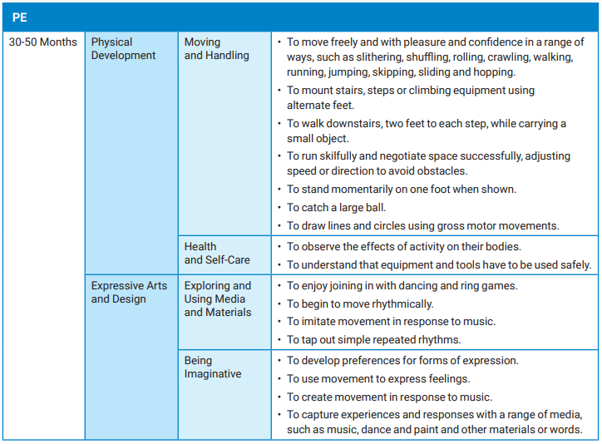
Learning in EYFS
Implementation

Slide 16
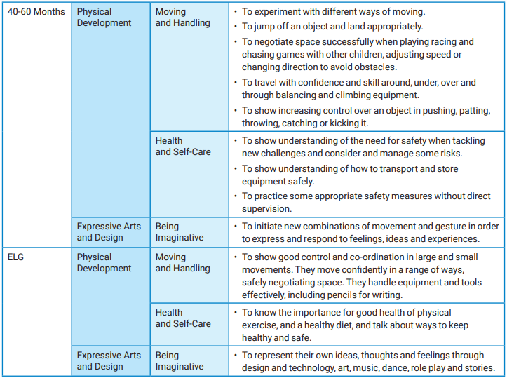
Learning in EYFS
Implementation

Slide 17
Units of work: EYFS
Intent
 | Reception Curriculum Map for Physical Education
 | Term 1 (1) Sept-Oct | Term 1 (2)Nov-Dec | Term 2 (3)Jan-Feb | Term 2 (4)Feb-April | Term 3 (5) April-May | Term 3(6)June-July
Time | 7 Weeks(-2/3 Sept) | 6/7 Weeks( -xmas wk) | 6 week ( –18/2) | 6 Weeks (-8/4) | 5 6 Weeks (-2/5) | 6/7 Weeks(last week)
Year R | Outdoor Games Daily mile | Daily mile Fundamentals of movement Unit 1 | Daily mile Gymnastics | Daily mile Fundamentals Unit 2 | Daily mile Field Games/Parachute play | Daily mile Field Games
 | Forest School Yoga/Dance | Forest School Yoga/Dance | Forest School Yoga/Dance | Forest School Yoga/Dance | Forest School Yoga/Dance | Forest School Yoga/Dance

Slide 18
Units of work: Key Stage One
Intent
 | Key Stage 1 Curriculum Map for Physical Education
 | Term 1 (1) | Term 1 (2) | Term 2 (3) | Term 2 (4) | Term 3 (5) | Term 3 (6)
Time | 7 Weeks(-2/3 Sept) 2nd Sept-22nd Oct | 6/7 Weeks( -xmas wk) 1st Nov-17th Dec | 6 week ( –18/2) 6th Jan-17th Feb | 6 Weeks (-8/4) 28th Feb-7th April | 5 Weeks (-2/5) 25th April-27th May | 6/7 Weeks(last week) 6th June-21st July
Year 1 | Daily mile | Daily mile Gymnastics floor work | Daily mile Dance/Yoga | Years 1-6 Virtual Dance Festival Thurs 7 Apr Daily mile | Daily mile | Daily mile
 | Fundamentals of movement unit 1 | Gymnastics low level apparatus | Fundamentals Unit 2 | Invasion games Tag games and football skills | Tennis | Athletics -Sports day All star cricket
Year 2 | Daily mile | Daily mile | Daily mile Gymnastics floor | Years 1-6 Virtual Dance Festival Thurs 7 Apr Daily mile | KS1 All Stars Cricket Festival Weds 18 May Daily mile | Daily mile
 | Fundamentals Unit 1 A.B.C | Tag games Cross country Basic orienteering games | Gymnastics low level apparatus | F.o.M Tennis | Field Games-sports day activities Track and field | All star cricket

Slide 19
Units of work: Lower Key Stage Two
 | Long Term Curriculum Map for Physical Education
 | Term 1 (1) | Term 1 (2) | Term 2 (3) | Term 2 (4) | Term 3 (5) | Term 3 (6)
Time | 7 Weeks(-2&3 Sept) 2nd Sept-22nd Oct | 6/7 Weeks( -xmas wk) 1st Nov-17th Dec | 6 week ( –18/2) 6th Jan-17th Feb | 6 Weeks (-8/4) 28th Feb-7th April | 5 6 Weeks (-8/4) 25th April-27th May | /7 Weeks(-last week) 6th June-21st July
Year 3 | Daily mile Sportshall indoor athletics | Daily mile X country Ball Handling Skills Lesson (1-6) 72 | Daily mile Tennis | Yrs 3&4 Tag Rugby Skills Festival Weds 23 Mar Years 1-6 Virtual Dance Festival Thurs 7 Apr Daily mile Invasion games Tag rugby | Daily mile Dance | Daily mile Striking Fielding Games Lesson (1-6) 86
 | Daily mile Sportshall indoor athletics | Multi sports festival 23rd Nov Daily mile Netball S.P | Daily mile Gymnastics floor work with S.P | Yrs 3&4 Key Steps Gymnastics 16th March Yrs 3&4 Mixed Football Festival Thurs 31 Mar Daily mile Gymnastics apparatus with S.P | Daily mile Tri golf S.P | Daily mile Rounders S.P
Year4 | Daily mile Sportshall indoor athletics | Daily mile X country Invasion Games: Ball on the Ground Lesson (1-6) 5v5vfootball | Daily mile Dance Rugby And The Haka Lesson (1 – 6 | Yrs 3&4 Tag Rugby Skills Festival Weds 23 Mar Years 1-6 Virtual Dance Festival Thurs 7 Apr Daily mile Tag Rugby | Daily mile Field games Sports day | Daily mile Tennis
 | U11 Boys/Mixed 7v7 Football Weds 6a team 12th b team Oct Daily mile Sportshall indoor athletics | Multi sport festival 23rd Nov? Daily mile Invasion Games: Ball on the Ground Lesson (1-6) 5v5 football | Daily mile Dodgeball | Yrs 3&4 Key Steps Gymnastics 16th March Yrs 3&4 Mixed Football Festival Thurs 31 Mar Daily mile Tag rugby | Primary School Games Thurs 23 Jun Daily mile Field games Sports day Swimming | Daily mile Rounders/cricket Swimming
Intent

Slide 20
Units of work: Upper Key Stage Two
 | Long Term Curriculum Map for Physical Education
 | Term 1 (1) | Term 1 (2) | Term 2 (3) | Term 2 (4) | Term 3 (5) | Term 3 (6)
Time | 7 Weeks(-2&3 Sept) 2nd Sept-22nd Oct | 6/7 Weeks( -xmas wk) 1st Nov-17th Dec | 6 week ( –18/2) 6th Jan-17th Feb | 6 Weeks (-8/4) 28th Feb-7th April | 5 6 Weeks (-8/4) 25th April-27th May | /7 Weeks(-last week) 6th June-21st July
Year 5 | U11 Boys/Mixed 7v7 Football Weds 6/12 Oct Daily mile X country/ orienteering | Daily mile Sportshall indoor athletics | U11 Swimming Gala Tues 15 Feb Daily mile Dance | Years 1-6 Virtual Dance Festival Thurs 7 Apr Daily mile Gymnastics floor | ^{U11 Orienteering Thurs 5 May} Daily mile Netball | U11 Boys / Mixed Kwik Cricket Tues 7 Jun Daily mile
 | U11 X country Thurs 30 Sep U11 Girls 7v7 Football Festival Thurs 21 Oct Daily mile X country/ Orienteering. O/A | U11 Quicksticks Hockey Competition Thurs 11th Nov Daily mile Sportshall indoor athletics Dodgeball | Daily mile Tag rugby | Daily mile Gymnastics apparatus Swimming | U11 BEE Netball Tues 24 May Daily mile Field games Sports day Swimming | U11 Quadkids Athletics Tues 28 Jun Daily mile Rounders/cricket Swimming
Year 6 | U11 x country Thurs 30 Sep P.G.L Daily mile | Daily mile Sportshall indoor athletics Dodgeball | U11 Swimming Gala Tues 15 Feb Daily mile Gymnastics -floor | Years 1-6 Virtual Dance Festival Thurs 7 Apr Daily mile Hockey | U11 BEE Netball Tues 24 May Daily mile Netball | U11 Boys / Mixed Kwik Cricket Tues 7 Jun Daily mile
 | U11 Boys/Mixed 7v7 Football Weds 6/12 Oct 14:30-18:00 Great Heath U11 Girls 7v7 Football Festival Thurs 21 Oct 14:00-18:00 Daily mile X country/ Orienteering. O/A | U11S Quicksticks Hockey Competition Thurs 11th Nov Daily mile Sportshall indoor athletics | Yrs 5&6 Sportshall Athletics Tues 18 Jan Daily mile Gymnastics apparatus | Daily mile Tennis | ^{U11 Orienteering Thurs 5 May} Daily mile Netball | U11 Quadkids Athletics Tues 28 Jun Daily mile Cricket/rounders
Intent

Slide 21
Example of planning
Implementation
Although we follow the same syllabus for Key Stage One and Two, we do adapt the plans in order that they are sufficient for both teachers to teach from and for students to learn.
Teachers are non-specialists and the plans have therefore been set out to ensure that staff have the information and training they need in order that they can successfully deliver the lessons to our students.

Slide 22
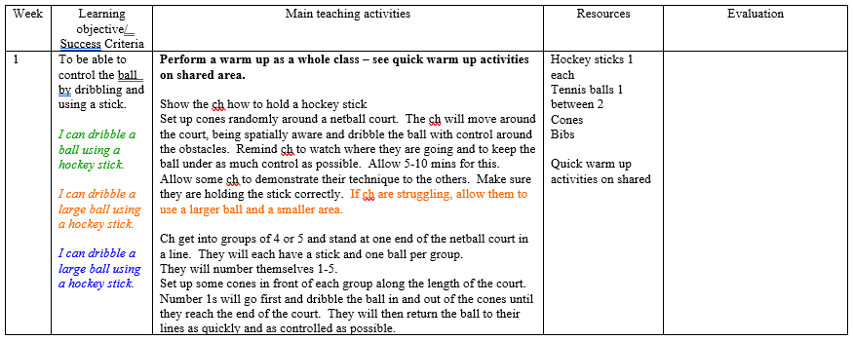
Example of planning
Implementation

Slide 23
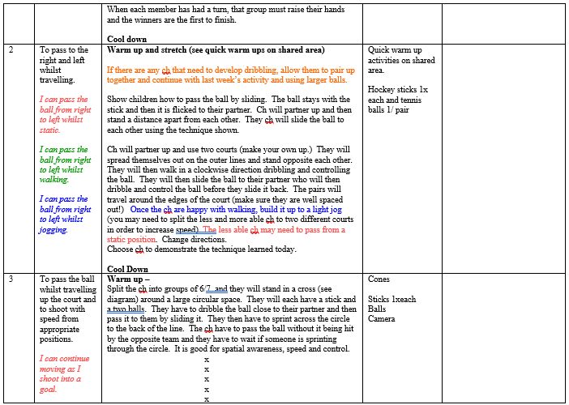
Example of planning
Implementation

Slide 24
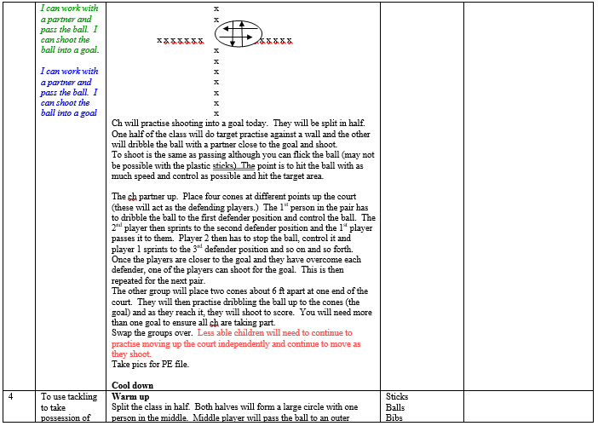
Example of planning
Implementation

Slide 25
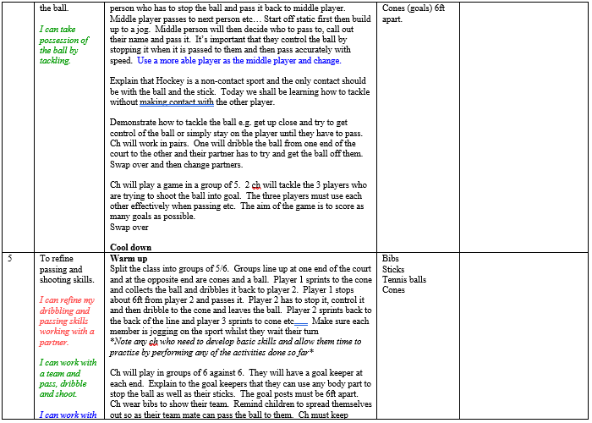
Example of planning
Implementation

Slide 26
Example of planning
Implementation

Slide 27
Physical Education Impact
Impact

Slide 28
Impact
At Ditton Lodge Community Primary School, we ensure that our PE curriculum is progressive and allows children to develop fundamental skills and apply them to a variety of sports and activities. All children are provided with the skills and given opportunities to demonstrate improvement to achieve their personal best. Our pupils are physically active, and this has positive implications for their well-being and learning in the classroom. Children understand how to lead a healthy lifestyle and understand the importance of exercise. Th recent pupil voice survey data showed children enjoy PE and develop a love of sport, and physical activity, that they attend sport outside of school hours. All pupils understand the values and importance of fair play and being a good sportsperson. The PE curriculum helps children become confident to take initiative, lead activities and encourage them to become lifelong participants in sport and games. Sports Ambassadors regularly update the board.
Impact

Slide 29
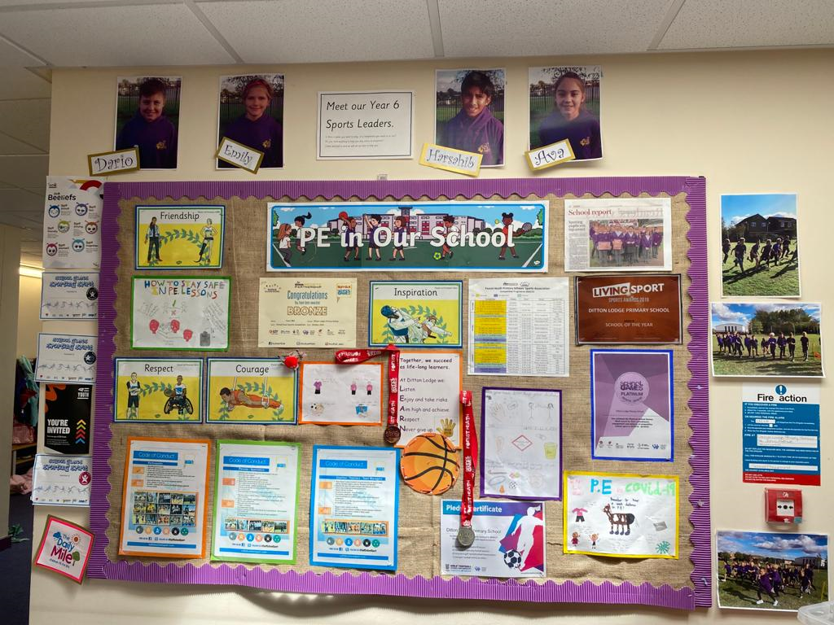
Impact
Impact

Slide 30
Impact
Ditton Lodge Primary School Sports Premium Report and Impact
The sport premium is allocated by the government to fund additional and sustainable improvements to the provision of P.E and sport for the benefit of primary aged pupils to encourage the development of healthy and active lifestyles. Allocation of the funding was calculated by using the number of pupils in year 1 to 6 as recorded in the census. The senior leadership team allocated funds in consultation with the sports leader in order to address where the biggest impact is required. Sports ambassadors and student council also are given input regarding how to make lunch time breaks more active by running a pupil surveys.
At Ditton Lodge our aims remain the same, to achieve self-sustaining improvement in the quality of PE and support in our school:
Engagement of all pupils in regular physical activity - kick starting healthy lifestyles
The profile of PE and sport being raised across the school as a tool for whole school improvement
Increased confidence, knowledge and skill of staff in teaching PE and sport
Broader experience of a range of sports and activities offered to all pupils
Increased participation in competitive sports
Impact

Slide 31
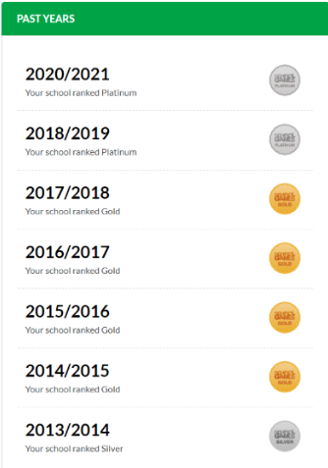
How do you measure the impact of Physical Education teaching?
Impact
Pupil voice
Competition results
Fitness improvement
Observations
CPD feedback

Slide 32
Impact

Slide 33
Impact

Slide 34
Impact

